Slide 1
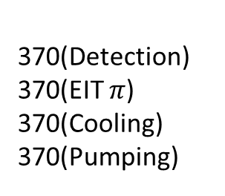
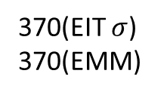
Spherical Octagon Chamber with Segmented Blade Trap System
Oven Cables
DC Cables
370(Protection)
399
935
355 Individual Beam, NA=0.1
Microwave Horn
370 Fluorescence Collection
NA=0.6
174
355 Vertical
171
355 Horizontal
B
PhotonGear Objective
174
370(Detection)
370(EIT $π$)
370(Cooling)
370(Pumping)
370(EIT $σ$)
370(EMM)
Side View
Helical Resonator
Top View

Slide 2
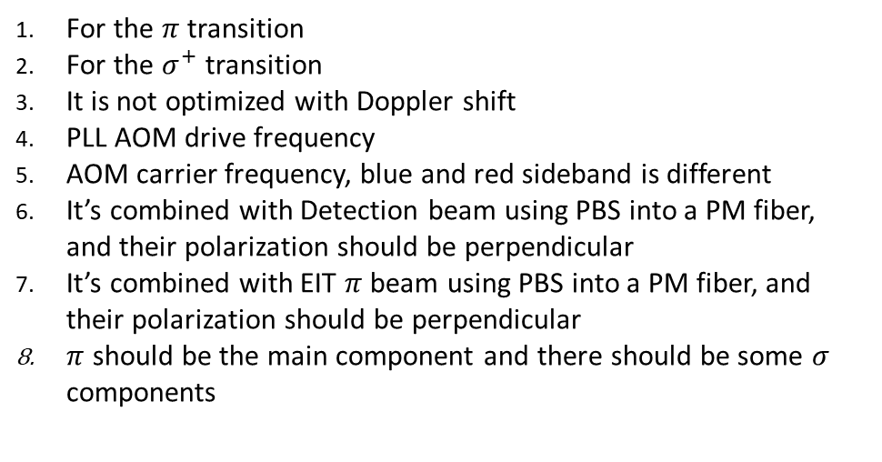
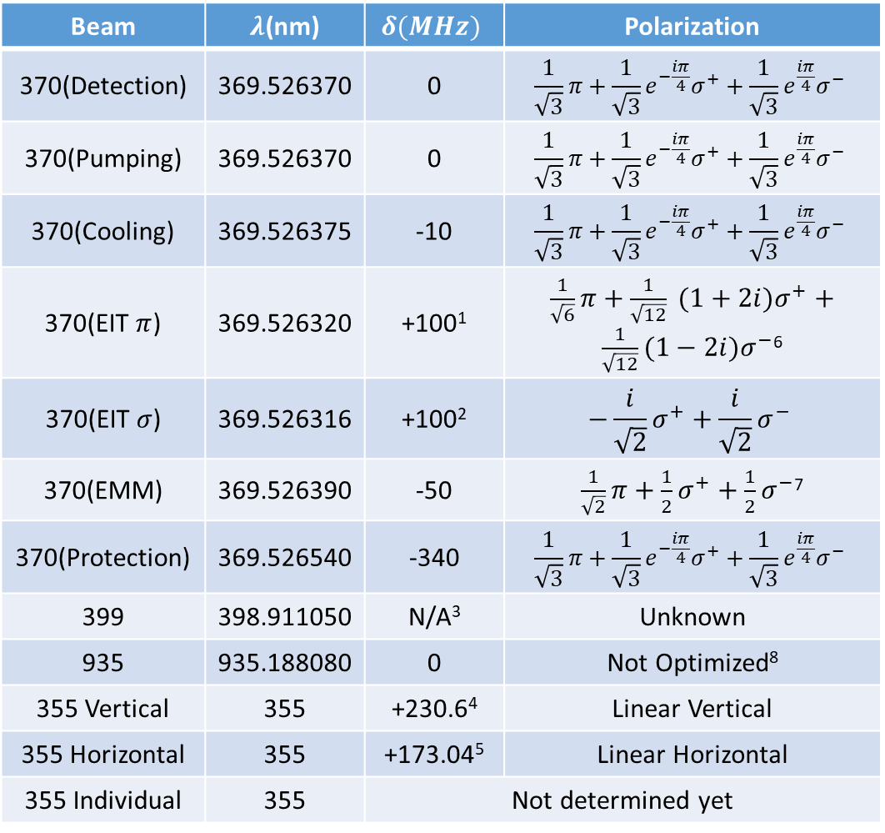
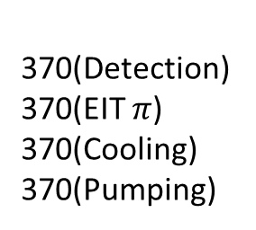
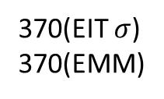
Laser Configurations
Oven Cables
DC Cables
370(Protection)
399
Beam | $λ$(nm) | $$δ(MHz)$$ | Polarization
370(Detection) | 369.526370 | 0 | $$\frac{1}{\sqrt{3}}π+\frac{1}{\sqrt{3}}e^{−\frac{iπ}{4}}σ^{+}+\frac{1}{\sqrt{3}}e^{\frac{iπ}{4}}σ^{−}$$
370(Pumping) | 369.526370 | 0 | $$\frac{1}{\sqrt{3}}π+\frac{1}{\sqrt{3}}e^{−\frac{iπ}{4}}σ^{+}+\frac{1}{\sqrt{3}}e^{\frac{iπ}{4}}σ^{−}$$
370(Cooling) | 369.526375 | -10 | $$\frac{1}{\sqrt{3}}π+\frac{1}{\sqrt{3}}e^{−\frac{iπ}{4}}σ^{+}+\frac{1}{\sqrt{3}}e^{\frac{iπ}{4}}σ^{−}$$
370(EIT $π$) | 369.526320 | +100¹ | $\frac{1}{\sqrt{6}}π+\frac{1}{\sqrt{12}} (1+2i)σ^{+}+\frac{1}{\sqrt{12}}(1−2i)σ^{−}$⁶
370(EIT $σ$) | 369.526316 | +100² | $$−\frac{i}{\sqrt{2}}σ^{+}+\frac{i}{\sqrt{2}}σ^{−}$$
370(EMM) | 369.526390 | -50 | $\frac{1}{\sqrt{2}}π+\frac{1}{2}σ^{+}+\frac{1}{2}σ^{−}$⁷
370(Protection) | 369.526540 | -340 | $$\frac{1}{\sqrt{3}}π+\frac{1}{\sqrt{3}}e^{−\frac{iπ}{4}}σ^{+}+\frac{1}{\sqrt{3}}e^{\frac{iπ}{4}}σ^{−}$$
399 | 398.911050 | N/A³ | Unknown
935 | 935.188080 | 0 | Not Optimized⁸
355 Vertical | 355 | +230.6⁴ | Linear Vertical
355 Horizontal | 355 | +173.04⁵ | Linear Horizontal
355 Individual | 355 | Not determined yet
935
Microwave Horn
174
355 Vertical
B
171
355 Horizontal
174
370(Detection)
370(EIT $π$)
370(Cooling)
370(Pumping)
370(EIT $σ$)
370(EMM)
Helical Resonator
Top View
For the $π$transition
For the $σ^{+}$ transition
It is not optimized with Doppler shift
PLL AOM drive frequency
AOM carrier frequency, blue and red sideband is different
It’s combined with Detection beam using PBS into a PM fiber, and their polarization should be perpendicular
It’s combined with EIT $π$ beam using PBS into a PM fiber, and their polarization should be perpendicular
$π$ should be the main component and there should be some $σ$ components

Slide 3
Objective and Windows
Objective | NA | WD(mm)
PhotonGear Objective | 0.6 for 370, 0.1 for 355 | 16.7
Window | Usage | View Area Diameter(mm) | Distance to Ions(mm) | Thickness(mm)
Top Recessed Window | 370 Fluorescence Collection and 355 individual beam | 50 | 15 | 4
Bottom Standard Window | Not in Use | 68.33 | 34.44 | 6.35
Side Window(6) | Laser Beam Access | 16 | 60.17 | 2.16
RF Feedthrough | Feedthrough to helical resonator with the down port of the chamber
DC and Oven feedthroughs | Connected to the main vacuum body and the cables are connected through the up port of the chamber
SAES
DC
Oven
Helical resonator

